Slide 1


FULL STACK WEB DEVELOPMENT WITH JAVA
Lecture-2

Slide 2
Today’s Agenda
JDBC Packages.
Steps Required In JDBC Programming.

Slide 3
Steps Of Connectivity
There are 7 steps to connect any java application with the database
in java using JDBC. They are as follows:
Import the required packages
Load and Register the driver class(Automatically Done By Java From JDBC 4.0 Onwards)
Obtain the connection
Obtain the statement
Executing queries
Process the result
Close the connection

Slide 4
Step 1
As previously mentioned , the JDBC API requires the support of java.sql
Thus as the first step we need to import this packages

Slide 5
The java.sql Package
The java.sql package contains the entire JDBC API that sends SQL (Structured Query Language) statements to relational databases and retrieves the results of executing those SQL statements.
The JDBC 1.0 API became part of the core Java API in Java 1.1.

Slide 6
Step - 2 Loading And Registering The Driver
We must register the driver in our program before we use it.
Registering the driver is the process by which the Oracle driver's class file is loaded into the memory, so it can be utilized as an implementation of the JDBC interfaces.
However from JDBC 4.0 this step is not needed to be done by us.

Slide 7
STEP 3
Create the connection object:
The getConnection() method of DriverManager class is used to establish connection with the database.
Syntax:
1) public static Connection getConnection(String url)
throws SQLException
2) public static Connection getConnection (String url,String name,String password) throws SQLException
Example:
Connection con=DriverManager.getConnection(
"jdbc:oracle:thin:@//Sachin-PC:1521/xe","system","password");

Slide 8
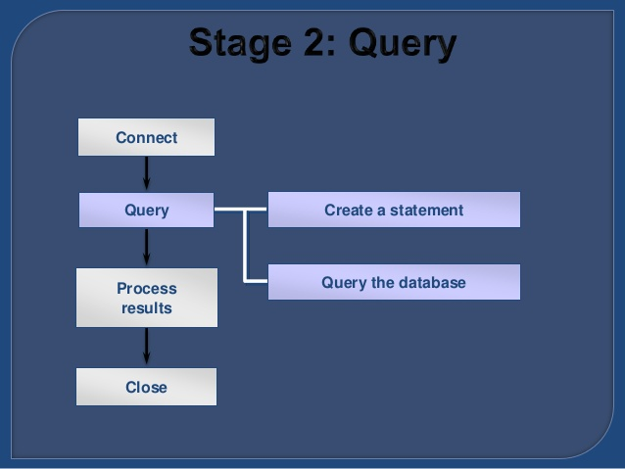
QUERY

Slide 9
STEP4
Create the statement object:
The createStatement() method of Connection interface is used to create statement. The object of statement is responsible to execute queries with the database.
Syntax:
public Statement createStatement()throws
SQLException
Example:
Statement stmt=con.createStatement();

Slide 10
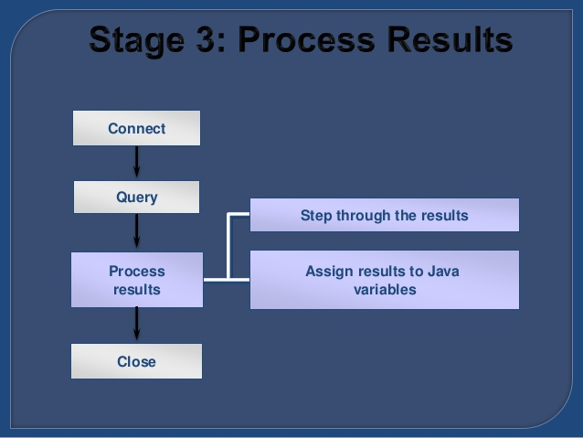
Process Result

Slide 11
STEP 5 & 6
Execute the query:
The executeQuery() method of Statement interface is used to execute queries to the database. This method returns the object of ResultSet that can be used to get all the records of a table.
Syntax:
public ResultSet executeQuery(String sql)throws
SQLException
Example:
ResultSet rs=stmt.executeQuery("select * from emp");
while(rs.next()){
System.out.println(rs.getInt(1)+" "+rs.getString(2));
}

Slide 12
STEP7
Close the connection object:
The close() method of Connection interface is used to close the connection. By closing connection object statement and ResultSet will be closed automatically
Syntax :
public void close()throws SQLException
Example :
con.close();

Slide 13
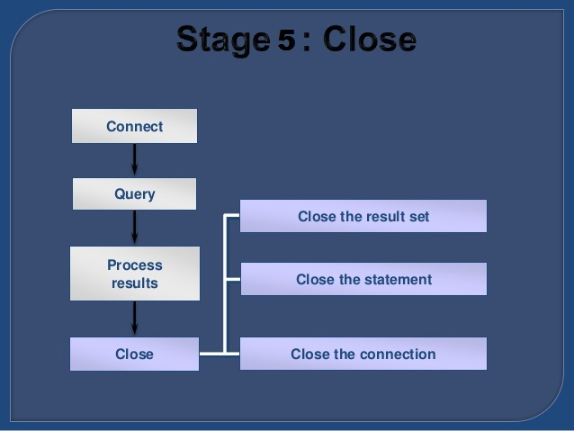
CLOSE

